Slide 1

DO YOU REALLY KNOW WHAT YOUR CUSTOMERS ARE TALKING ABOUT?
Yelp Review Analysis
MSBA 6330 & MSBA 6320
Team 10
Boyang Wei, Yi-Li Yu, Xiangke Chen,
Elizabeth Zhu, Lin Xu, Yusha Wang
Notes:
Hi we are team 10.
Today we are presenting yelp review case to help restaurant owner better understand their clients from their text reviews.

Slide 2

CONTENTS
Business Background
Technical Architecture
Algorithm Behind
Dashboard Demonstration
Future Improvement
Notes:
Our presentation will cover 5 key modules, including the identified business problem, technical architecture, algorithm and models behind the architecture, solution demonstration, and finally reflect on future improvement regarding our project.

Slide 3
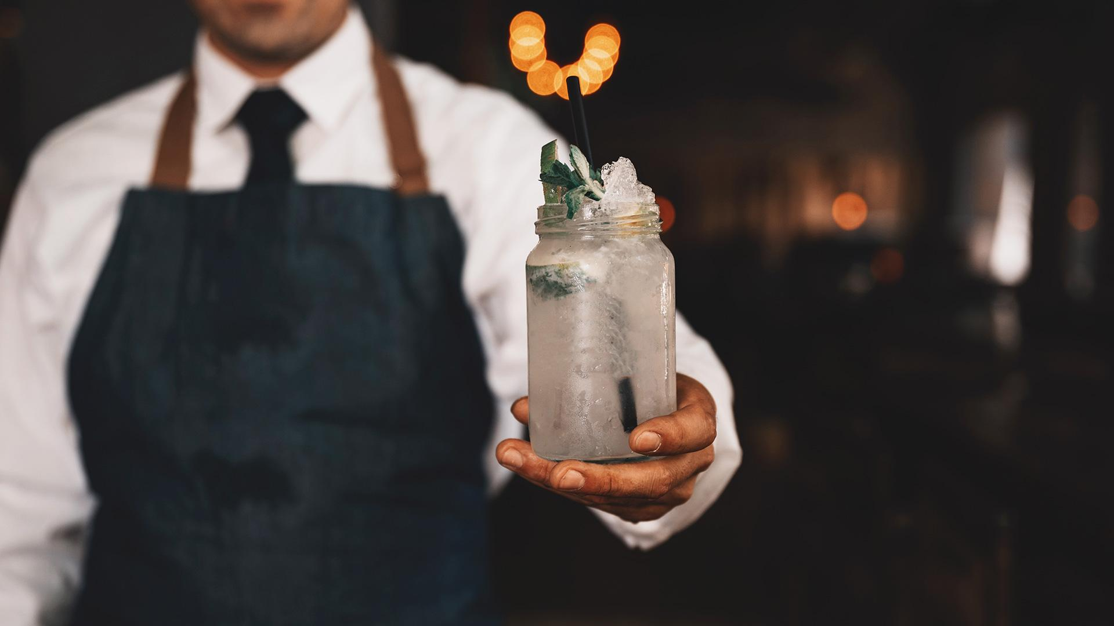
01
BUSINESS
BACKGROUND

Slide 4
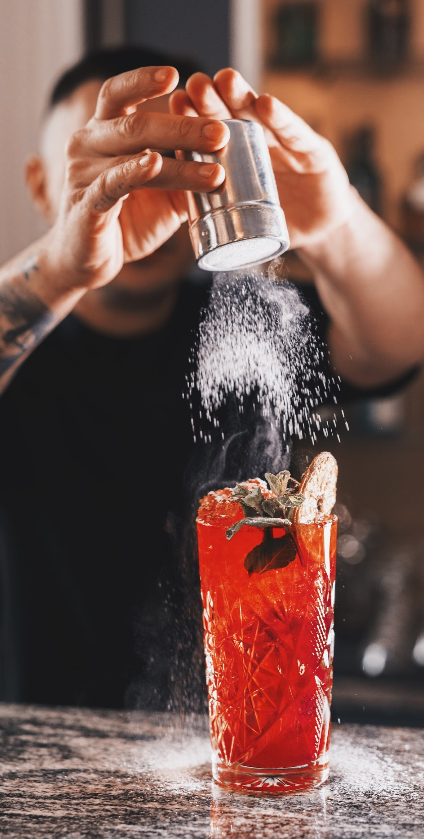
BUSINESS COMPLICATIONS
What Restaurant Owners Concern Most While Facing Large Quantity of Volatile Review Data?
01
Does customers’ rating reflect their actual comments?
02
What’s their key messages in their comments? And how can we improve?
Notes:
As restaurant owners who received tons of text reviews continuously via Yelp website, they might facing multiple pain points in better understand their clients. First is whether customers’ rating stars actually reflect their comments? For example, a customer who gave you 5 stars might also leave some negative comments to motivate you to improve. Those are the message you specifically want to capture because then you will know where to improve and convert those regular customers into loyal customers.
Another pain point is that by simply reading into this many text reviews manually, restaurant owners can be difficult to identify the key messages behind each review, whether they are talking about positive or negative things? What they are complaining about or praising about?

Slide 5




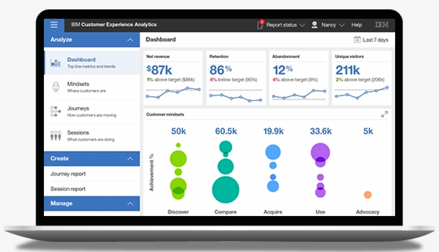
BUSINESS FLOW
Restaurant Customers
Serve Better
Restaurant Owners
Give
Feedback
Gain
Insights
Yelp Database
Our Analysis
Dashboard
Notes:
This page is introducing our overall business flow.
Individual restaurant clients will leave their ratings and comments on yelp website. Then our analysis will conduct on yelp database and essentially convert into one integrated solution - dashboard, which will allow restaurant owners gain insights regarding their own restaurant and competitors’ situation. Therefore, restaurants can serve their clients better by understanding their demand and needs.

Slide 6
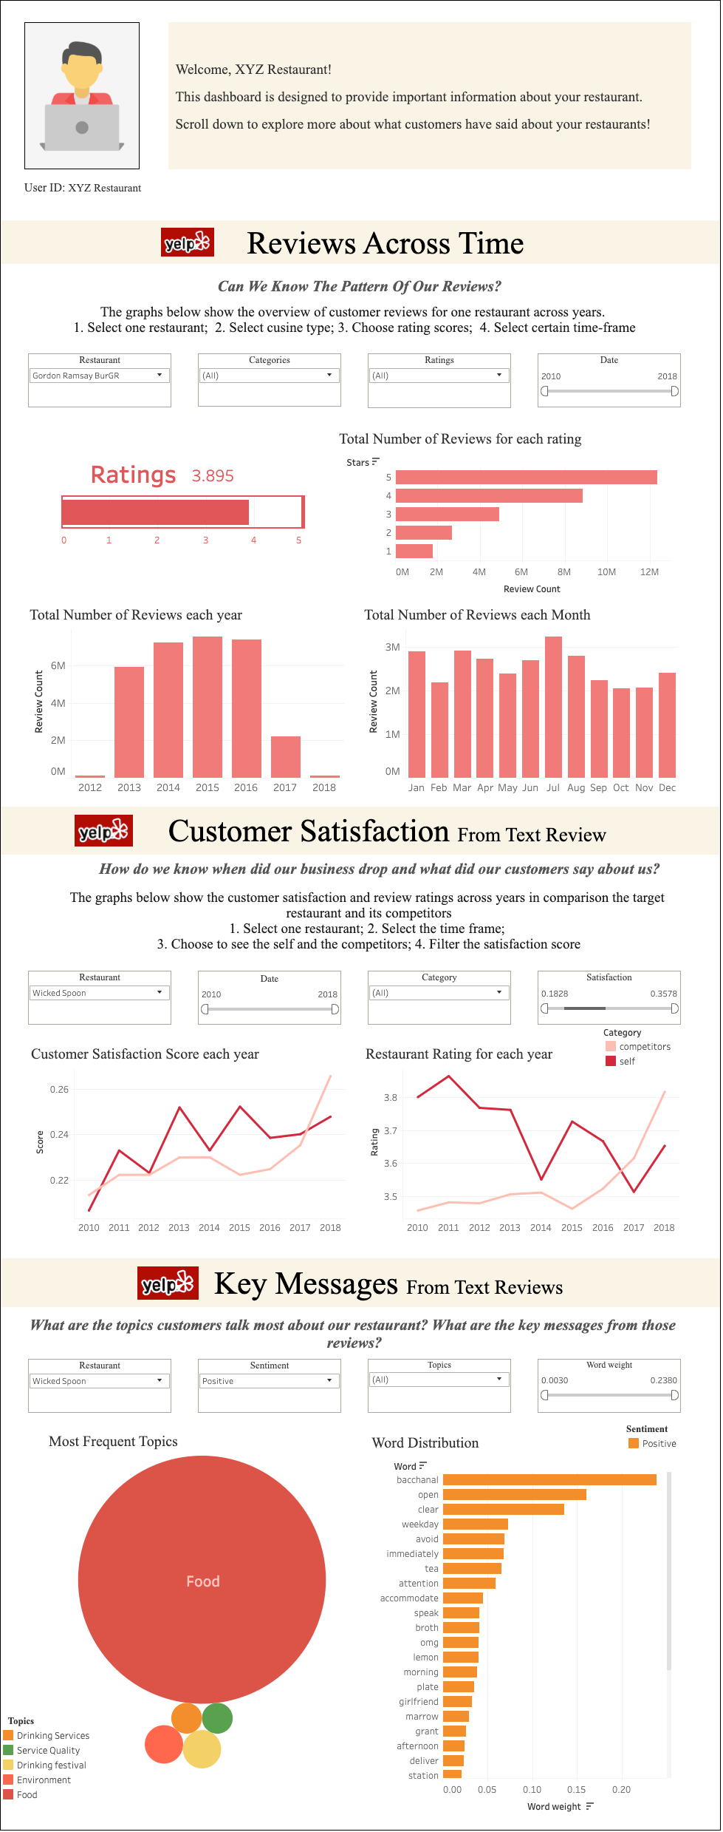
INTEGRATED SOLUTION
Review Sentiments Comparison between The Self and The Competitors
Welcome Page
Owner Profile
Review Counts Across Years and Months for Different Restaurants
Frequent Topics Identified from Customers’ Reviews
Notes:
Here I want to give you a glance at our integrated deliverable which will be demonstrated later in details.
We will deliver restaurant owners one integrated dashboard containing welcome page, owner profile, review counts across years and month, review sentiments analysis as well as topic identifications.
In next module, Yusha will introduce you the technical architecture and platforms behind our business use case.

Slide 7

02
TECHNICAL ARCHITECTURE

Slide 8


YELP DATASET SUMMARY
Business
Review
Json file provided by yelp
Including information about each individual business
Size: 132 MB
Json file provided by yelp
Including information about review context and date
Size: 5 GB
192,609 Businesses
6,685,900 Reviews

Slide 9





TECHNICAL ARCHITECTURE
01
02
03
04
05
Data input
Pre-processing
Transformation
Analysis
Visualization

Slide 10
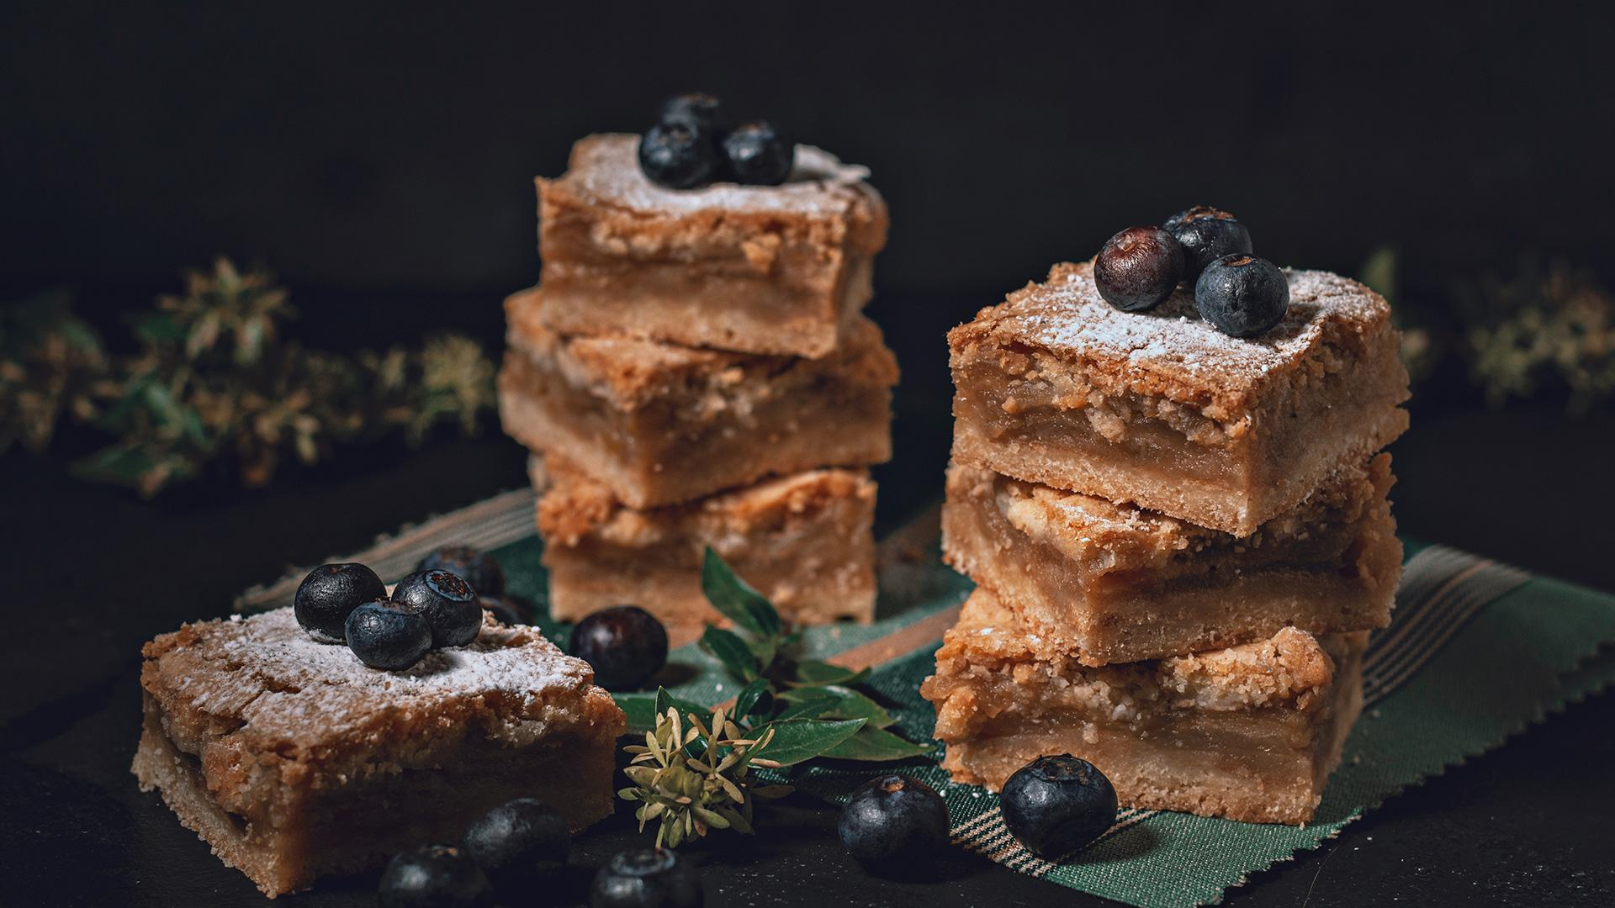
03
ALGORITHM
BEHIND

Slide 11


SENTIMENT ANALYSIS
Definition
Goal
Sentiment Analysis, also known as opinion mining, is the process of determining whether a text unit is positive or negative.
Analyze sentiment changes over time
Build a rating predictor based on review sentiment
Notes:
To solve the mismatch between rating and textual comments, we use sentiment analysis to quantify opinion solely based on text reviews. Sentiment analysis, also known as opinion mining, is the process of determining whether a text unit is positive or negative.This technology can be widely applied to reviews for a variety of applications such as discover how people feel about a particular topic.
In our project, we will first analyze sentiment changes over time.Then we build a rating predictor based on review sentiment

Slide 12
SENTIMENT SCORE
NLTK
TextBlob
Sentiment Trends
1
Textual Review
Pre-processing
Calculating Sentiment Score
0
-1
Removing Stopwords
Tokenization
Stemming
Lemmatization
Polarity
Positive
Negative
Notes:
The raw text is pretty messy for these reviews so before we can do any analytics we need to clean things up. The NLTK package can deal with various preprocessing problem such as removing stopwords, stemming and Lemmatization.Then we use Textblob package to calculate polarity to assess sentiment score for each review. Polarity ranges from -1 (most negative) to 1 (most positive).
Once each review was assigned its sentiment score, this information is averaged to indicate overall customer sentiment for each restaurant over time.

Slide 13


UNIFORM THE
RATING STANDARDS
Predictive ratings based on text features
Analytical Flow
N-Gram
Combination of words
TF-IDF
Extract more precise information from the review
SVM model
Predict uniform ratings
Notes:
So, how can we specify every review more granularly?
In common sense, stars with 4 or 5 are perceived as good and others are
We decided to build a model to predict the ratings based on the information extracted from comments. The process is as shown in the slides, we first implemented n bag of words to capture more reasonable combination of words and then continue with TF-IDF algorithms to distinct each comments from others. Finally, we vectorized all the features into sparse vector and predict the ratings in our svm model.

Slide 14
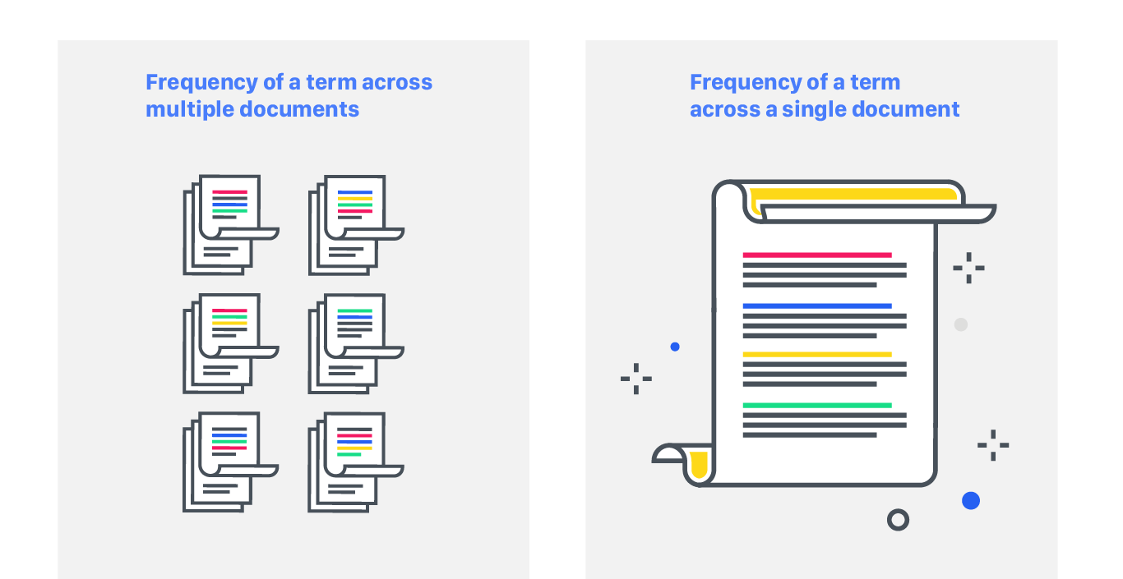
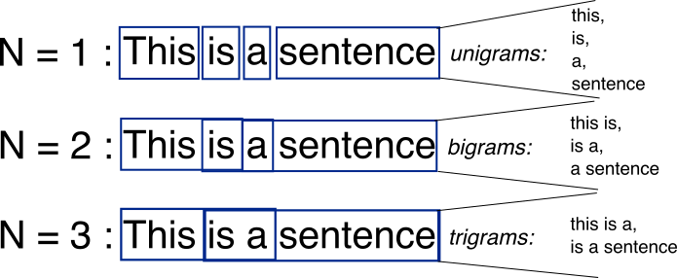
TEXT TRANSFORMATION
N-Gram
TF-IDF
Store context of review with a more well-understanding space
Enable the text analysis to scale up (with more information)
Term Frequency
Inverse Document Frequency
Capture the relevance between each sentence
Notes:
To detail our text data pre-processing, we first remove the stop words and punctuation to get rid of the noise. Then we applied ngram and tfidf to those features.

Slide 15


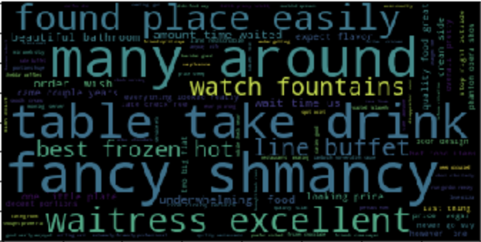
PREDICTIVE MODEL
Model
Performance
SVM model (activation : SGD)
Dependent variable:
label 1 ( 4 & 5 stars)
label 0 ( 0 - 3 stars )
Independent variables:
Vectorized TF-IDF features
Predict the label base on text features (uniform standard)
Top 20 positive ( label 1 ) bag of words
Notes:
With the
Classify words of comments with label 1 (positive rating) and label 0 (negative rating)

Slide 16
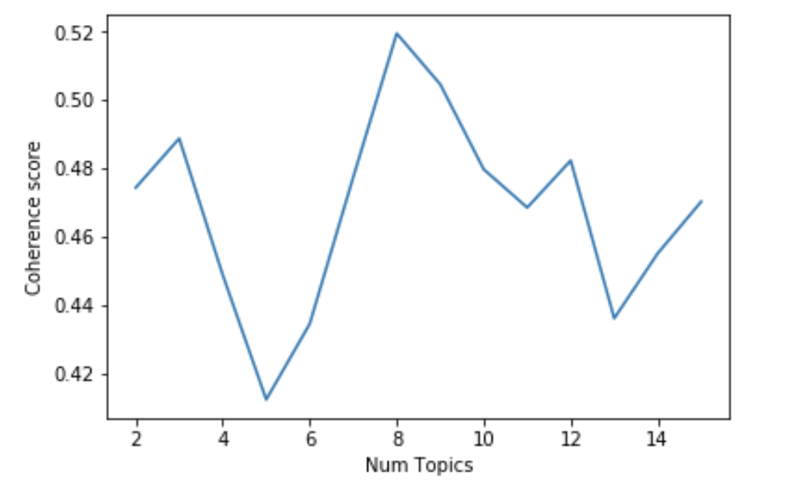
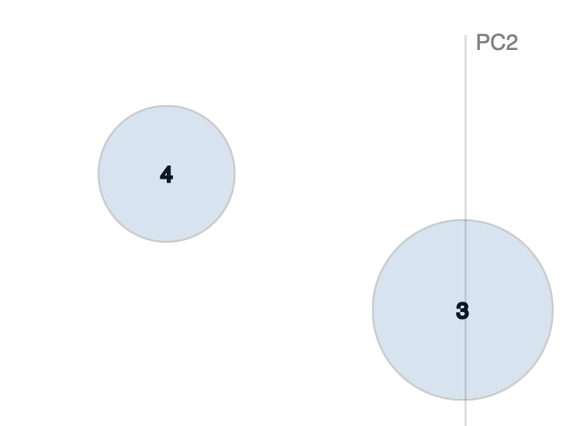
TOPIC MODELING
Determine number of topics in positive and negative reviews
1
2
Determine topic weights
Coherence Score
Area of the circle
Notes:
After we identified positive and negative sentiments, we would like to further explore what specific messages they conveyed. For example, among all negative reviews, what aspects of restaurants do they talk about the most? Do they complain about food, services or environments?
To solve this problem, we used topic modeling to identify key messages or topics customers are talking about. There are several steps involved in this algorithm. Firstly, we need to determine the number of topics covered in all positive/ negative reviews. This is determined by the coherence score. In general, the higher the score is, the better number of topics we choose. For example, according to the graph on the right, topic number equals to 8 would be the ideal choice.
Then, after we select 8 topics, we can get topic weights based on the area of the circle on the right. For example, topic 3 has a larger area than topic 4. This means that more people are talking about topic 3. We would like to look into topic 3 further.

Slide 17
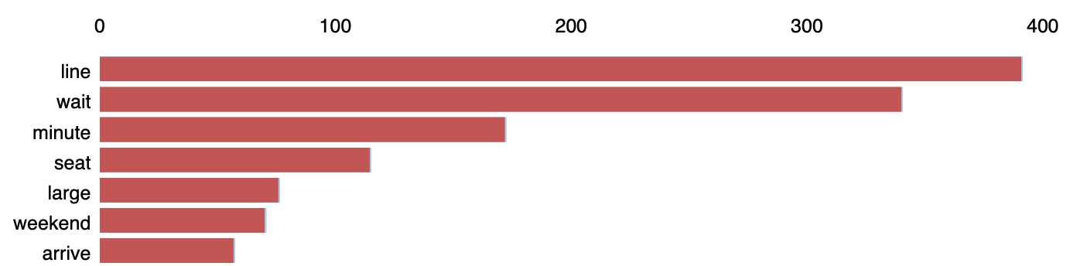

TOPIC
MODELING
Word distribution of
Topic 3
Identify Topic -
Reservation and waiting
Identify key words and word weights in each topic
Identify topic based on human judgement
Notes:
We can identify key words in topic 3 along with their importances in the graph shown below. We noticed that common words appeared in these topics are line, wait, minute ,seat, weekend, arrive and so on. Also, line, wait and minute are three major words in this topic. Considering the context of the restaurant, we identified topic 3 as reservation and waiting. This means that in all negative reviews, one major topic customers discussed is reservation and waiting. After this, Xiang ke will give you a demonstration of the dashboard that we developed for the business owner.

Slide 18

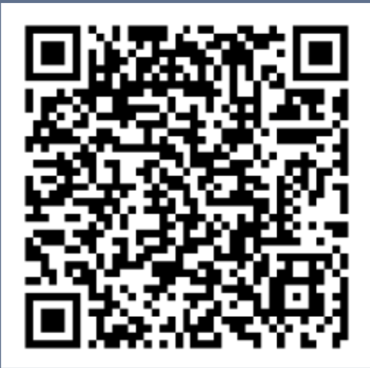
04
DASHBOARD
DEMONSTRATION
DashBoard
Demo

Slide 19
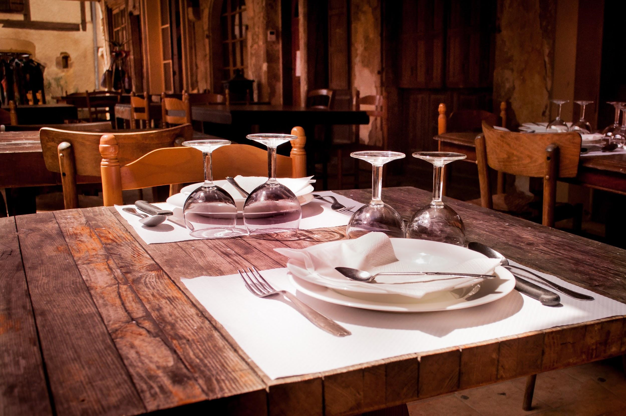
05
FUTURE
IMPROVEMENT

Slide 20
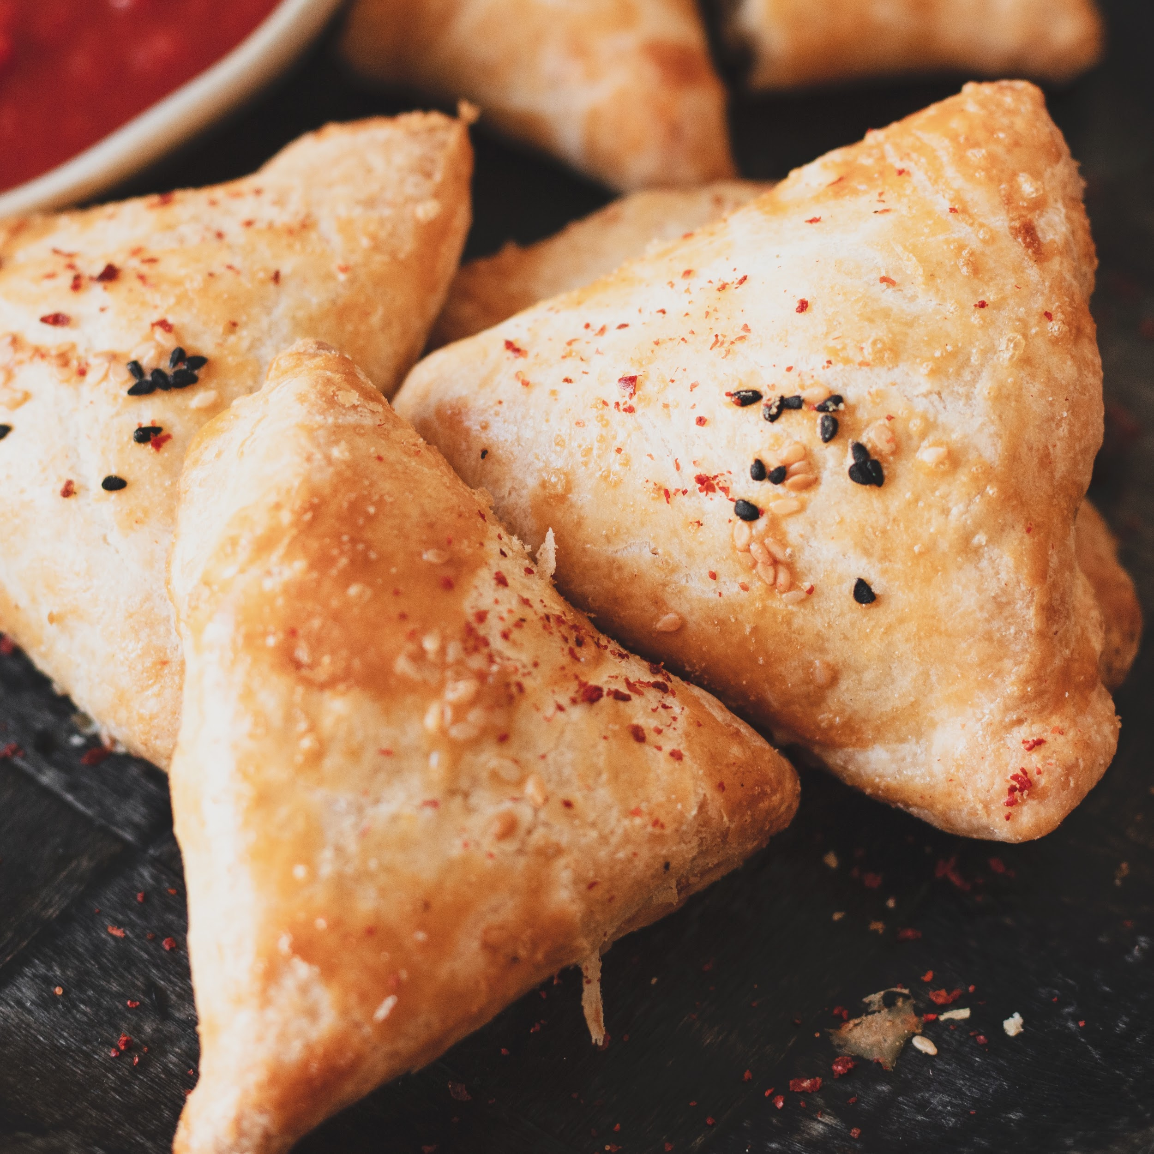
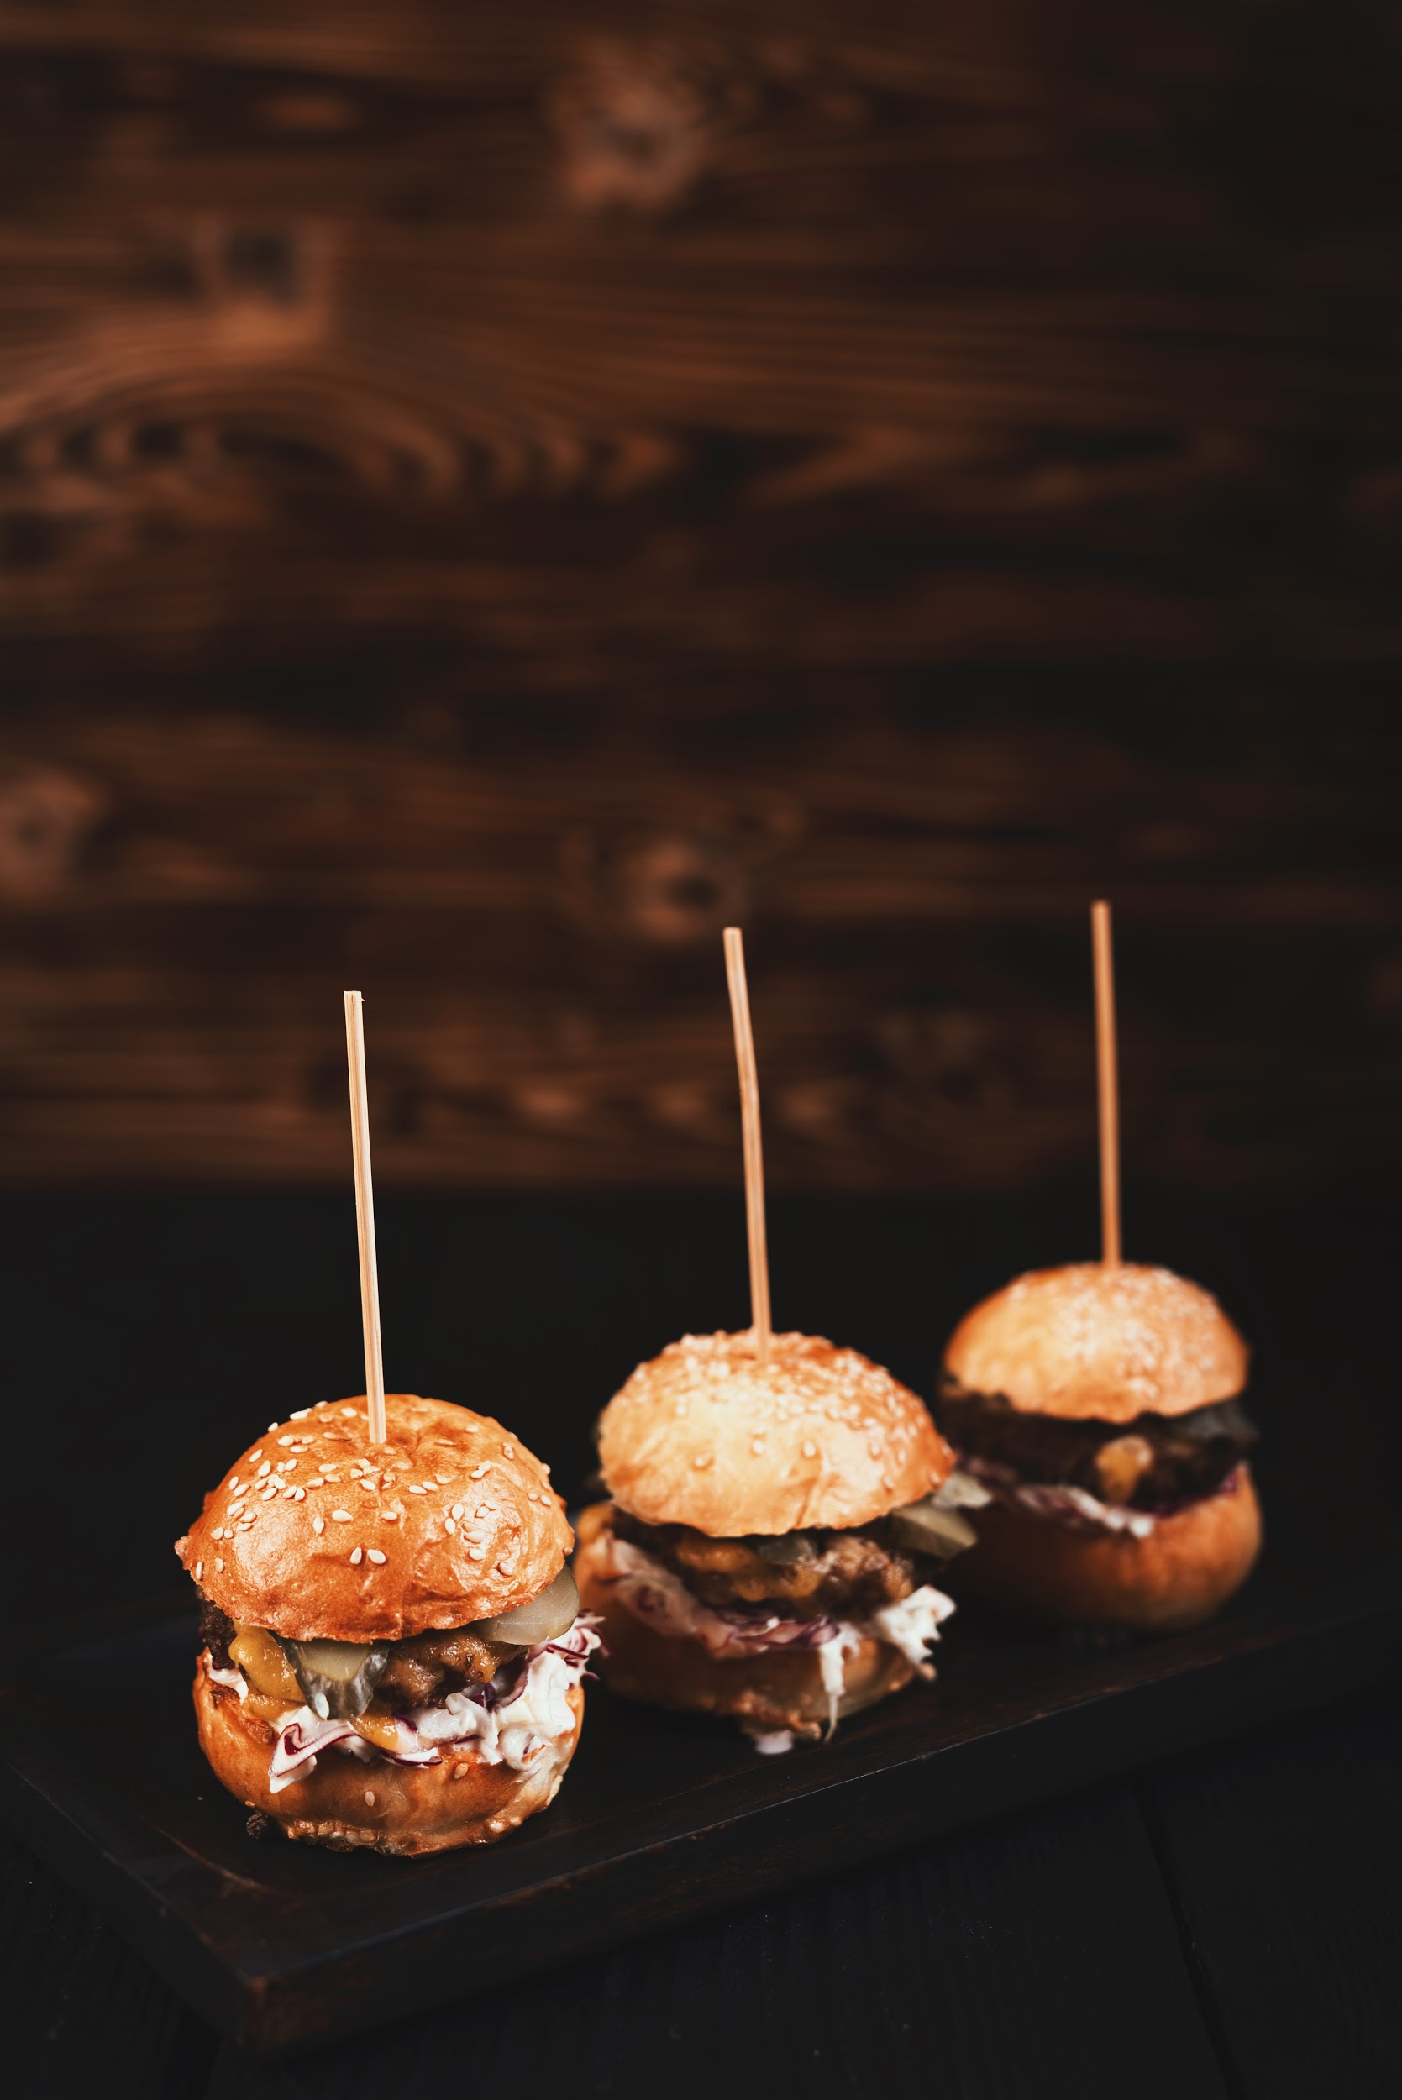
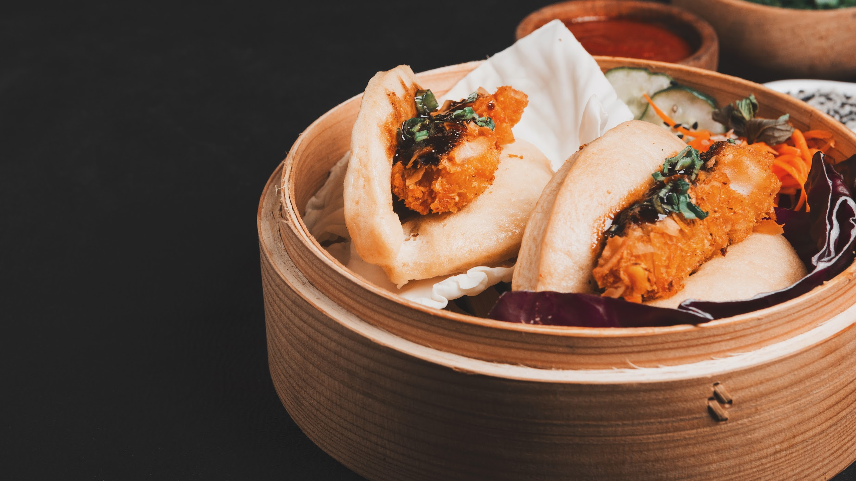
FUTURE IMPROVEMENTS
Automation in Tableau
Streaming Data
Track Back
We will automate the Tableau visualization by analyzing data entirely on AWS and connecting Tableau via AWS Athena
So far we analyzed only static data. In the future, we will reinforce the capability of analyzing streaming text data
We could have enabled dashboard users track identified individual word back to the original review
Notes:
Given the time constraint of this project, there are multiple limitations we noticed and wish to improve in the future use.
First of all, later on we could conduct our analysis on AWS platform and connect tableau via AWS athena to ensure the automation visualization on tableau.
Secondly, so far we analyzed only the static data but we would like to emphasize on the capability to process streaming text data in the future.
Last but not least, we will later enable the dashboard users track identified individual word back to the original review.

Slide 21

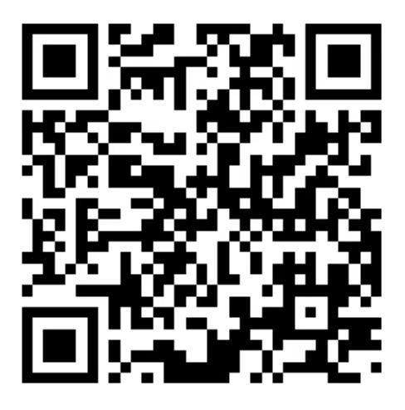
THANK YOU!
Does anyone have any questions?
Find us on Github
Notes:
This is end of our presentation. If you have any questions, please find us on Github. Thank you!

